Slide 1
Project of Media- Center in the City of Nizhnevartovsk Cinema Republic
(Siber Cinema)

Slide 2
Identity is wat you have for others When you are only for yourself you have no identity Only since the moment of acknowledging yourself as a connected with others, you became a person with identity. B. Ryahovsky,

Slide 3
The concept of development of Media Center
The foundation of the Republic of Cinema is the development of a youth film studio Which includes 4 main directions Animation, documentary, popular science, feature films.
The main method of cognition in the youth film studio is the method of movement from the particular to the general, from experience to generalization, from practice to theory. It is difficult to expound to adolescents the theory of an object that they have not heard about and have not encountered in their practice. The immersion method and pedagogy of cooperation allow creating conditions for creativity and are the basis on which further training is built. That is why the basis of the first stage is important, where the necessary emotional experience accumulates, supported by theoretical knowledge.
The process of immersion in the world of professions begins with the most simple and familiar material for a particular group of young people and continues until the first "why". Only when there is a need for analysis in them, we turn to theoretical generalizations. Each theoretical lesson must end with the synthesis of a new idea and the design of a new situation for practice.

Slide 4
The main objectives and tasks of the center are
General pedagogical goals:
Help
Activation
Formation
Helping a teenager in the process of self-knowledge and self-development. Maximizing his creative abilities harmonization of the processes of growth of self-development, self-improvement.
Activation of cognitive interests, expansion of horizons of cognition; help in mastering the skills of interpersonal communication and cooperation, productive individual and collective activities.
Form a stable need for a creative attitude to life.
Didactic goal:
Practical skills
Acquisition of practical skills in the production and creation of animation, documentary and feature films.

Slide 5
Tasks are:
Attract and interest.
Give knowledge according to the work program.
To teach to apply in practice the knowledge received during the training.
Achieve maximum independence in filmmaking.
Notes:
Для достижения поставленных целей предусмативаеться ряд задач

Slide 6
FORM AND REGIME OF LESSONS
The program provides for a comprehensive form of conducting classes.
Work in small groups of 3-5 people. Classes are held in the format of a "creative laboratory" for 8-10 hours a week.
Notes:
Программа предусматривает комплексную форму проведения занятий.
Работа в малых группах по 3-5 человек.
Занятия проводится в формате «творческой лаборатории» по 8-10 часов в неделю в студии, на сцене, в территориальных пределах киностудии, а так же и за ее пределами, исходя из конкретно- поставленных педагогических задач.

Slide 7
Divisions of the Media Center Include 4 focuses
Animation
Documentary Filmmaking
Scientific-Popular Film Production
Feature Films

Slide 8
Animation
The way of creating cartoon- Classical animation, i.e. frame-by-frame shooting. Cartoon characters are made of plasticine, paper, lego and other creative materials.

Slide 9
Benefit from classes in the workshop
-Comprehensively develop the creative abilities of a child, adolescent
-New skills in teamwork and interaction with other students, socialization in society.
- Development of fine motor skills, memory, speech, thinking, emotional intelligence and imagination.
Training ability to concentrate.
The opportunity to try different activities and choose a lesson to your liking.
Psychological unloading.
Development of project skills.
Notes:
-Всесторонне развитие творческих способностей ребенка, подростка
-Навыки работы в команде и взаимодействия с другими студийцами, социализация в обществе.
- Развитие мелкой моторики, памяти, речи, мышления, эмоционального интеллекта и воображения.
Тренировка умения концентрироваться.
Возможность попробовать разные виды деятельности и выбрать занятие по душе - в игровой форме дети пробуют себя в роли мультипликатора, сценариста, монтажера, художника и звукооператора
Психологическая разгрузка, избавление от негативных эмоций, страхов, и зажимов- арт- терапия
Развитие навыков работы над проектами: дети учатся ставить цели, планировать и системно подходить к совей деятельности

Slide 10
3098
1 см= 10мм
все в мм
Hr = High of the ceiling
S= Space Area
510
1000
4000
Дверь Door 2012х1014
2050
Комната площадь S = 16,4
Высота потолков Нr = 2096
334
Дверь Door 2012х1014
1780
4043
Дверь Door 2012х1000
700
1014
1014
150
1014
3072
1140
2053
810
260
750
Окно Window 1020 Х 1725
Подоконник Windowsill Н = 925
150
140
300
2730
1020
Комната площадь S = 14,7
Высота потолков Нr = 3007
5096
1460
1000
1014
3082
910
1570
Окно Window1020 Х 1725
Подоконник Windowsill Н = 925
Комната площадь S = 14,7
Высота потолков Нr = 3007
5096
Дверь Door 2012х1014
2730
1020
260
5076
260
140

Slide 12
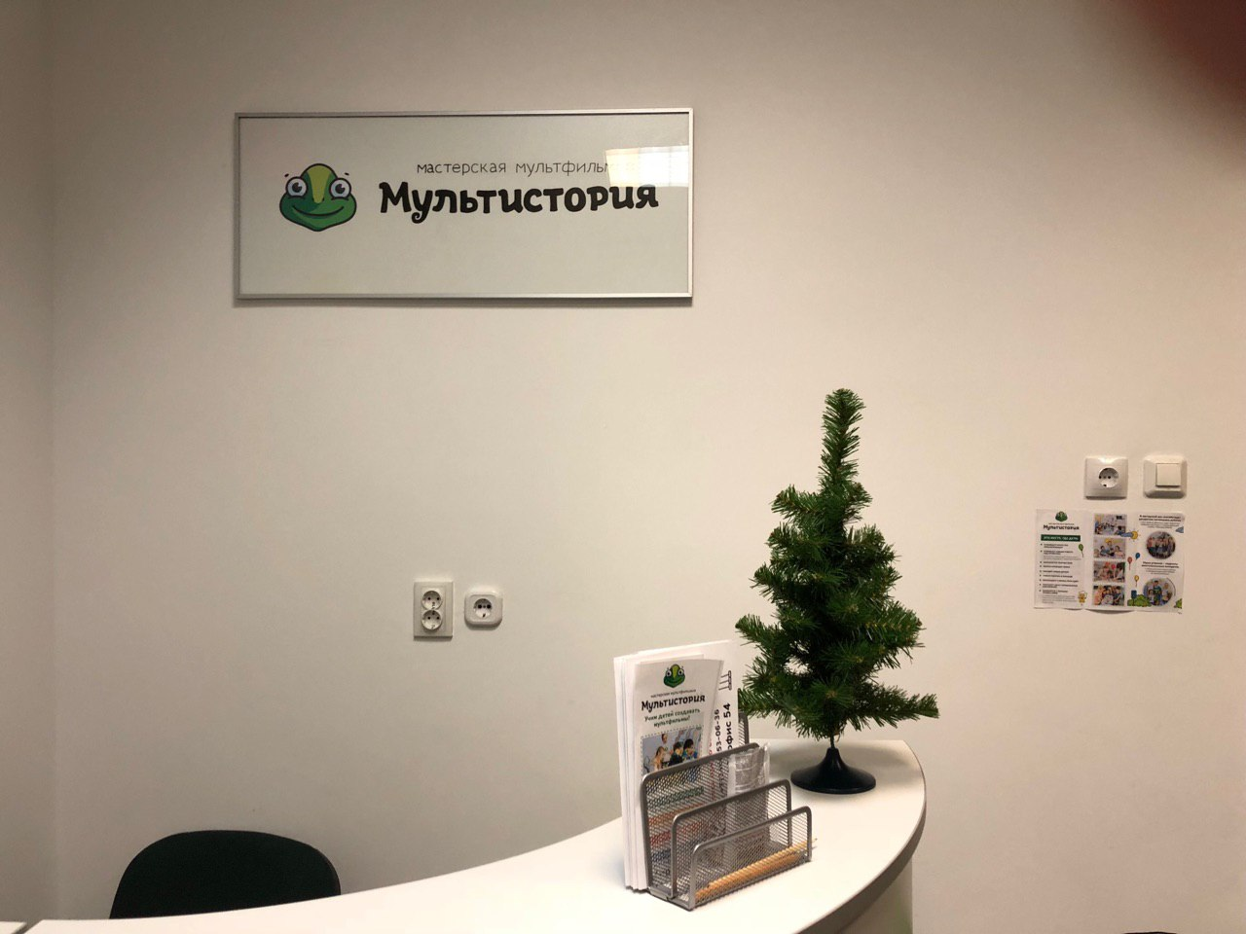
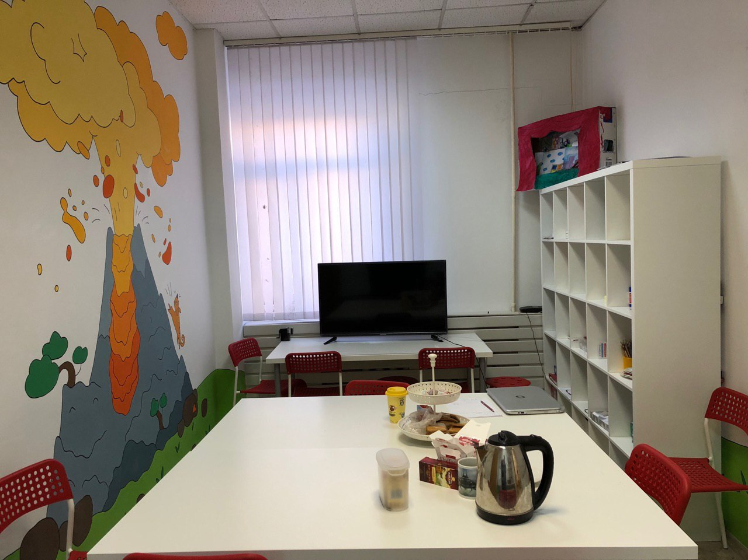
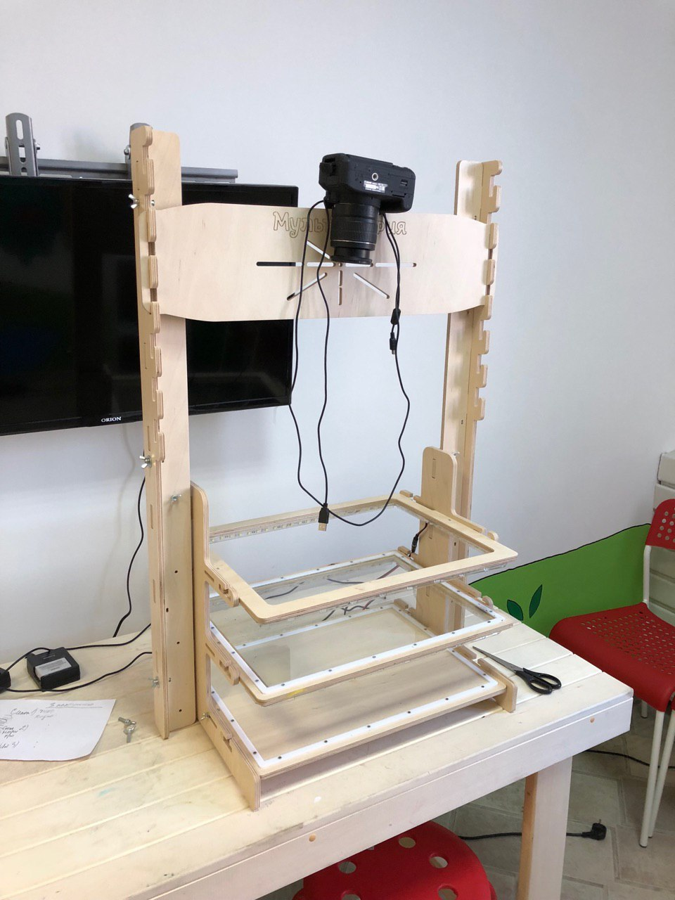
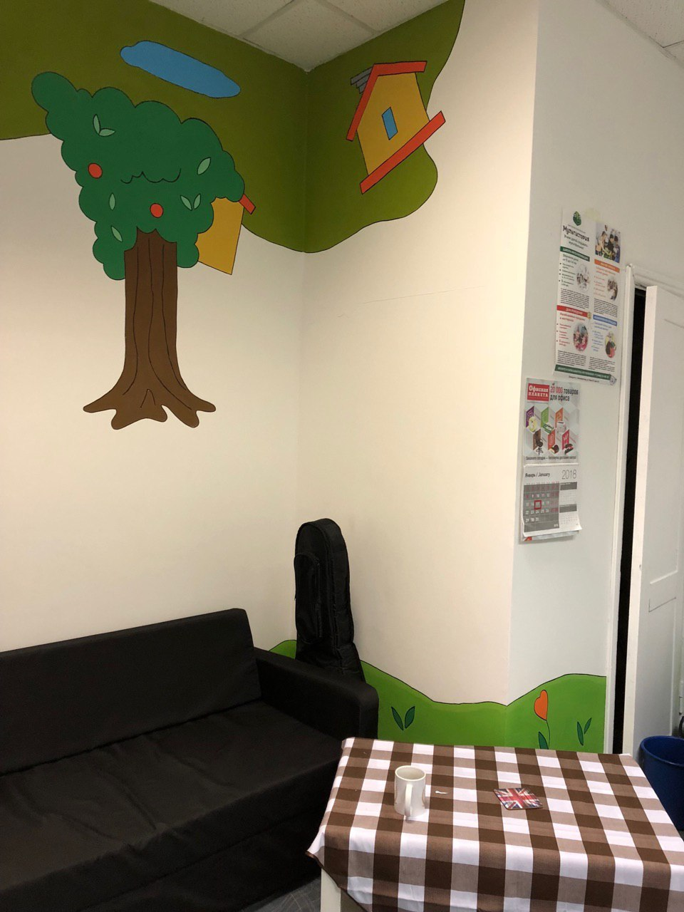
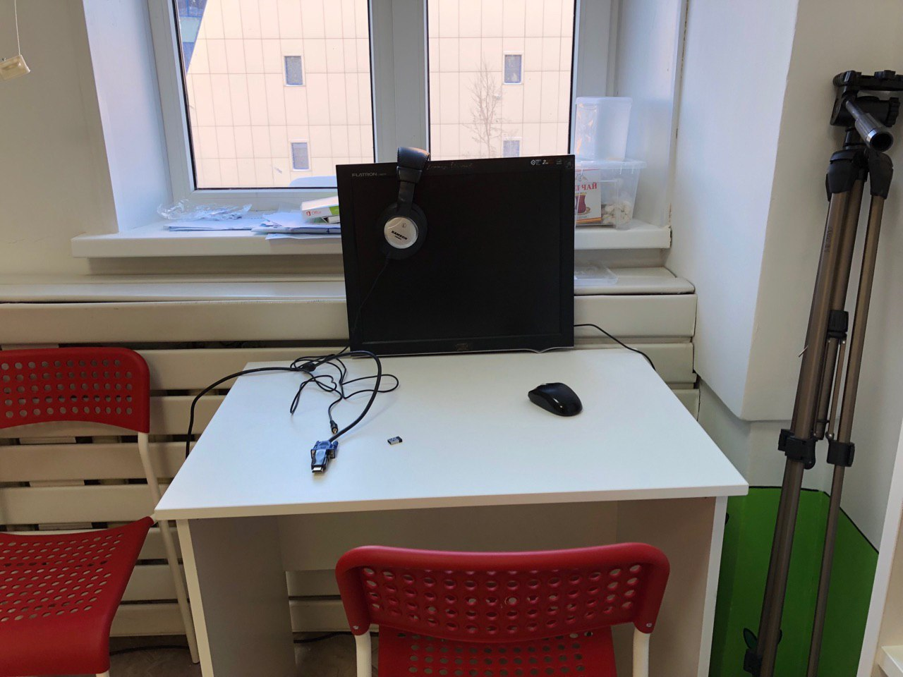
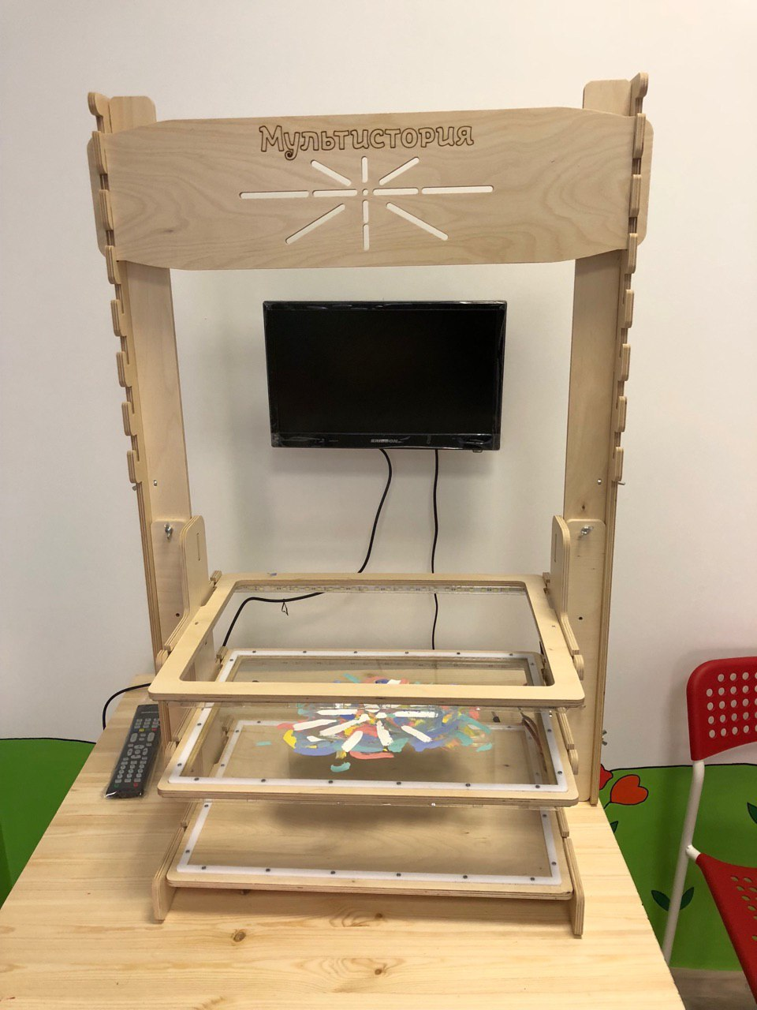
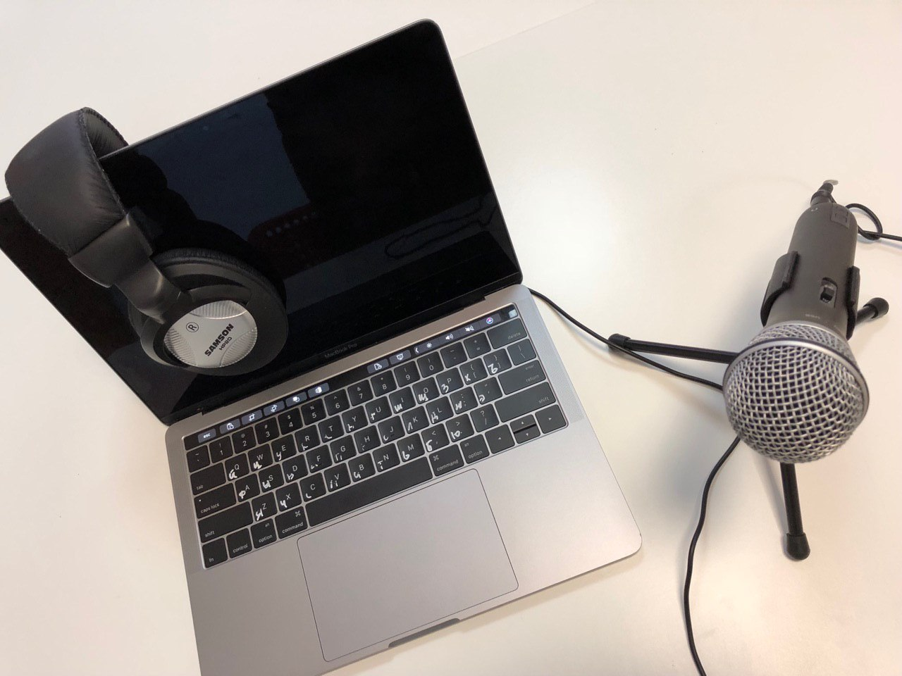
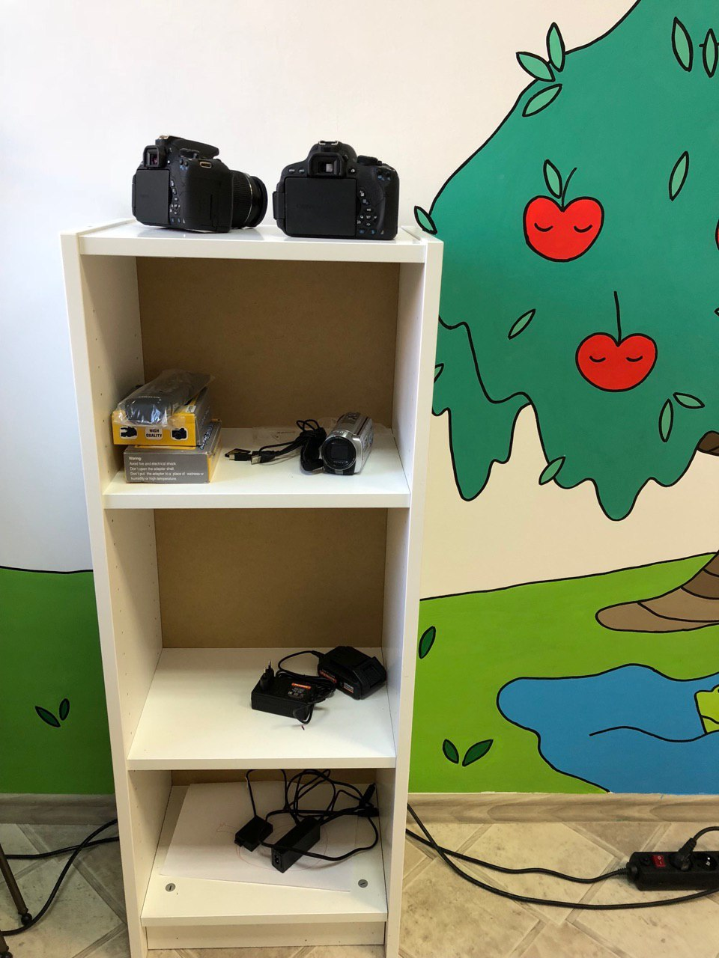
Reception
Auditorium
Workshop
Sitting Area
Animation machine
Editing table
Studio of Audio Record
Animation machine
Technical Equipment shelf

Slide 13
Documentary film
Documentary film:
(or non-feature film) is a kind of cinema. Documentary is a film based on the filming of authentic events and individuals.

Slide 14
Benefit from the employment of documentary
Cognitive benefit.
Ability to explore.
Ability to work with different kinds of information.
Development of communication skills.
Ability to analyze, filter and structure the information received.
Formation of the world, innher view and opinion (civil position).

Slide 15
Scientific-Popular Cinema
Popular science films
The film, shot according to a previously developed literary scenario, dedicated to showing the phenomena of nature, processes in the different fields of science, technology, industry and so on.
Notes:
Научно-популярный фильм — фильм, снятый по заранее разработанному литературному сценарию, посвящённый показу явлений природы, процессов в различных областях науки, техники, промышленности и сельского хозяйства^{[1]}. Задачей научно-популярного кинематографа является обнародование научных сведений, фактов и результатов исследований, описание на уровне общих понятий научных гипотез, идей, открытий, взглядов; может касаться как уже хорошо изученных вопросов, так и находящихся в процессе разработки, «на острие» науки. Таким образом научно-популярные фильмы также популяризируют научный подход к восприятию окружающей действительности.

Slide 16
Benefits from the creation of popular science films:
Enrichment of intellectual abilities
The opportunity to explore the area of ​​interest.
The ability to consider hypotheses with a scientific approach.
Ability to analyze, filter and structure the information received.
Development of technical abilities Improving research skills

Slide 17
Feature Films
Feature Films
Kind of motion picture, a feature film, a work based on a plot embodied in a script and interpreted by a director, created with the help of acting, camera and other arts
Notes:
Игровое кино — вид киноискусства. Игровой фильм — произведение, имеющее в основе сюжет, воплощённый в сценарии и интерпретируемый режиссёром, который создаётся с помощью актёрской игры, операторского и прочих искусств^{[1]}. Игровое кино противопоставляется неигровому кино, включающему документальное кино, мультипликацию и научно-популярное кино. В отдельных фильмах возможно смешение игры актёров и документалистики (художественно-документальное кино)^{[2]}. Также возможно создание мультфильмов с включением игры актёров (например, «Новый Гулливер», «Кто подставил кролика Роджера»), и участие актёров в научно-популярных фильмах.

Slide 18
Benefit from the creation of a feature film:
Development of acting skills.
Ability to interact in a team.
Perfection of memory.
Concentration of attention.
Development of attention.
Development of communication skills.

